Slide 1
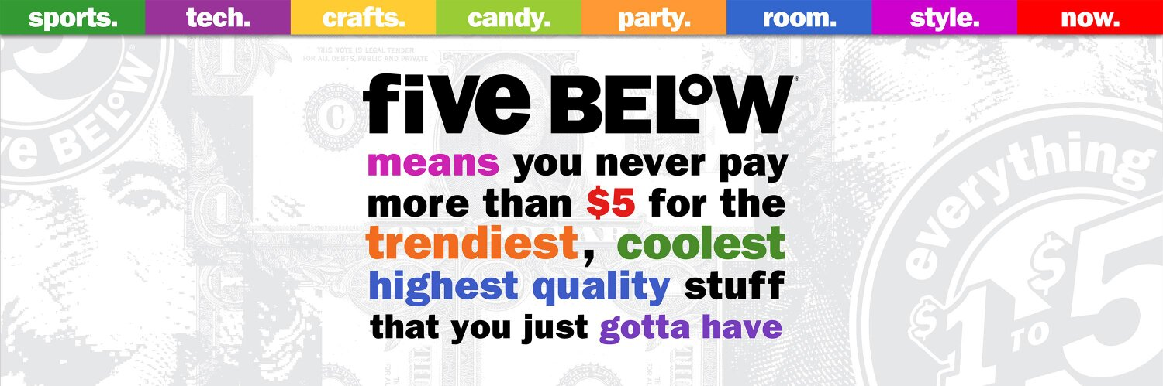
Team Lambda

Slide 2
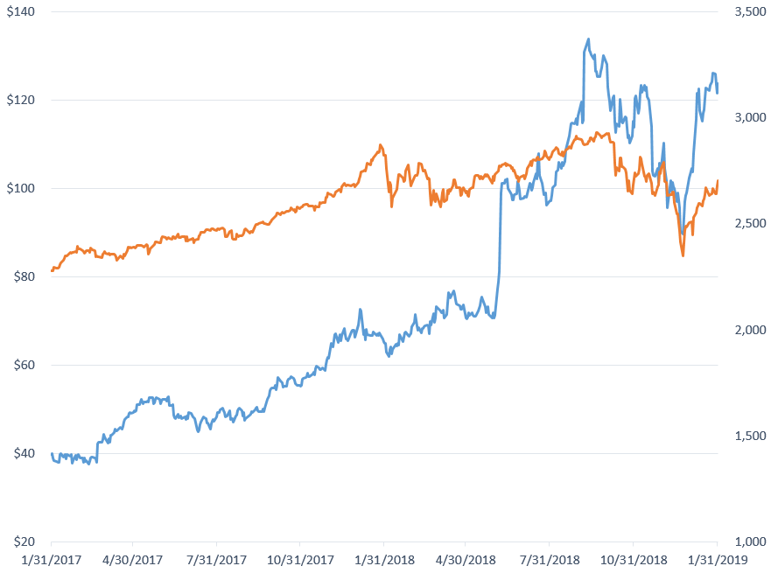
Executive Summary
HOLD
Target
$129.94
Market Profile
Ticker | FIVE
Sector | Consumer Staples
Closing Price (1/31/19) | $123.73
Market Cap | $6,899m
LTM P/E | 52.6x
LTM EV/EBITDA | 32.4x
FIVE
210%
Same Store Sales Driven by Expansion
Debt Free and Outstanding Financial Position
Valuation
DCF | $128.24
EV/EBITDAR | $135.12
PEG | $132.01
2019 Growth | 28.3%
WACC | 9.10%
S&P500
19%
Risk Hedging Efficiency

Slide 3
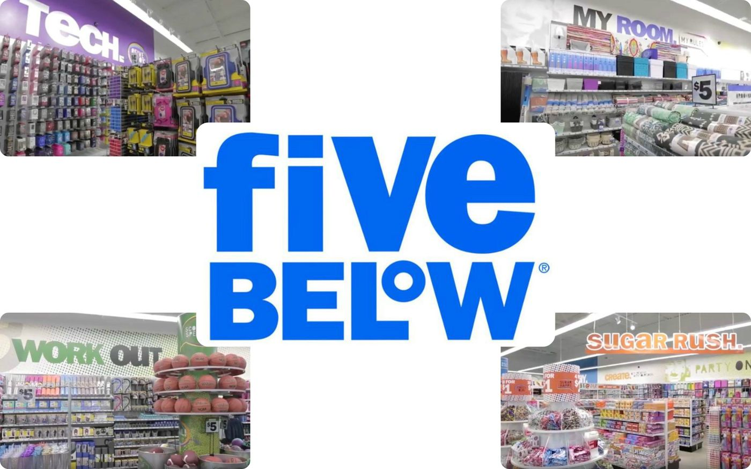
Business Description

Slide 4
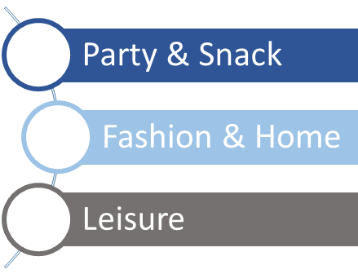
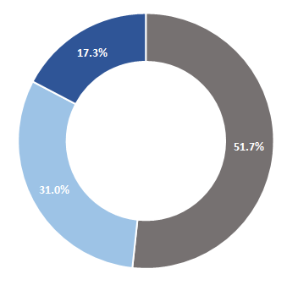
Diversified Segments
Candy
Party
Room
Style
Sales
Sports
Tech
Create
Now
Business Description
Industry Overview
Competitive Positioning
Financial Analysis
Corporate Governance
Valuation
Investment Risks

Slide 5
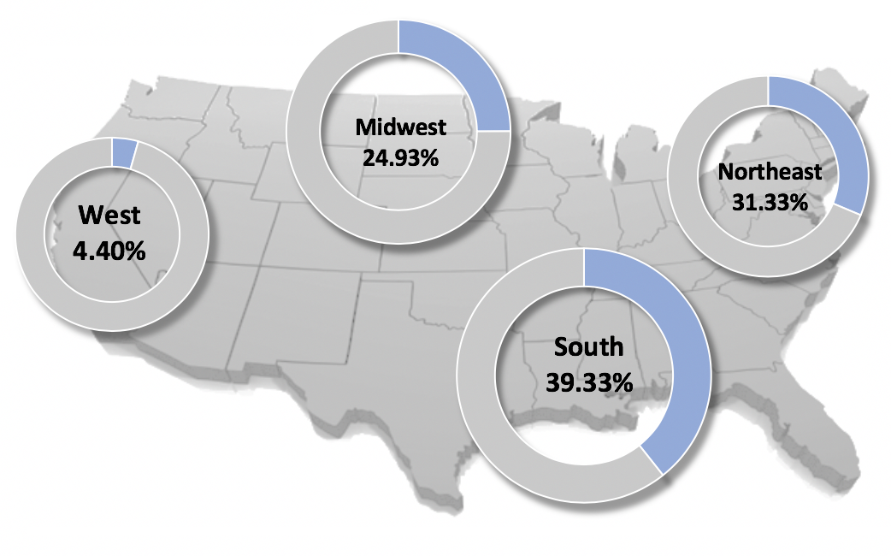
Geographical Regions
Region | 2018 | 2019E
South | 295 | 359
Northeast | 235 | 251
midwest | 187 | 232
West | 33 | 54
Total | 750 | 896
Business Description
Industry Overview
Competitive Positioning
Financial Analysis
Corporate Governance
Valuation
Investment Risks

Slide 6
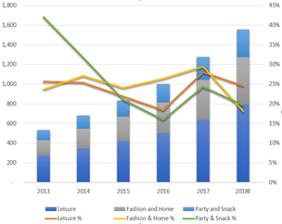
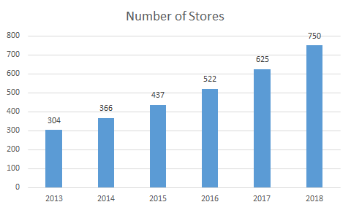

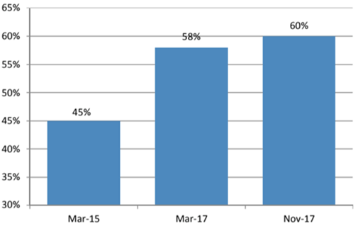
Unique Model
High Growth Strategy
New Store Openings
Densification Strategy
Increased Brand Awareness
Increased Revenue
Brand Awareness has increased by over 15% since 2015
Multiple Store Openings
Cuts pre opening costs
Lowers distribution costs
Increases Awareness
Average new store growth of 16.5% YoY
Revenue Growth CAGR 25%
Business Description
Industry Overview
Competitive Positioning
Financial Analysis
Corporate Governance
Valuation
Investment Risks

Slide 7
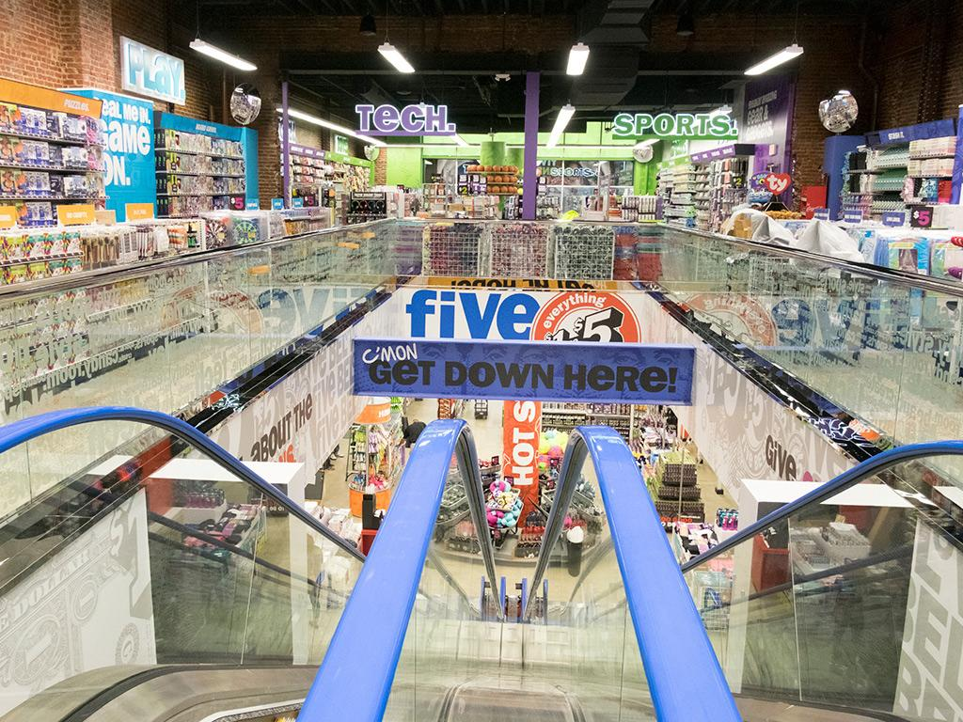
Industry Overview

Slide 8
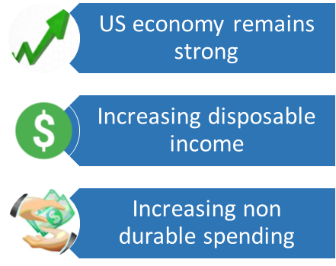
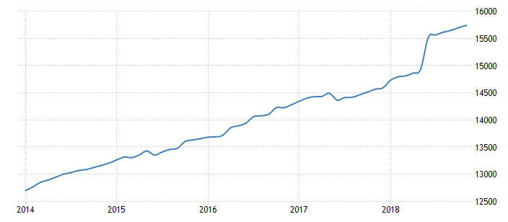
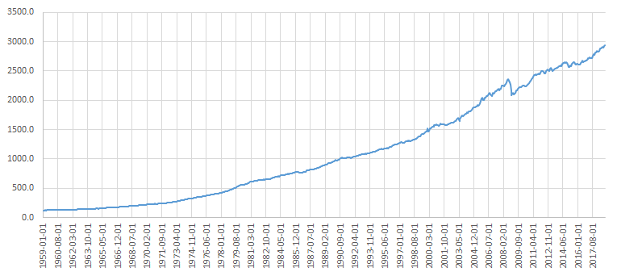
Economic Analysis
Trade war & Global economic slowdown
Economic conditions are worrisome but remain favorable overall
Disposable Income (Billions)
Non Durable Spending
Business Description
Industry Overview
Competitive Positioning
Financial Analysis
Corporate Governance
Valuation
Investment Risks

Slide 9
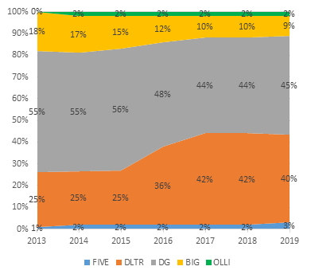
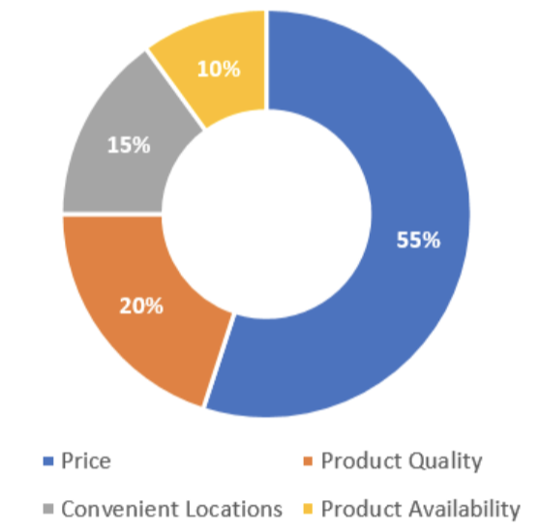
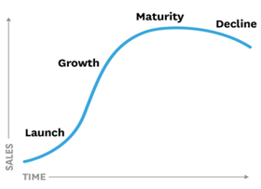
Industry Drivers
Most important factors consumers consider when purchasing products at a specialty value retail store:
Survey
Respondents: 116
Age Range: 18-30
Region: Northeast US
Price
Product Quality
Convenient Location
Retail Segment’s Life Stage
Product Availability
Value Drivers
Five Below’s Life Stage
Market Caps:
Five Below: 6.9B
Dollar Tree: 22.77B
Dollar General: 30.66B
Big Lots: 1.28B
Ollie: 5.45B
FIVE HAS A 3% MARKET SHARE
Business Description
Industry Overview
Competitive Positioning
Financial Analysis
Corporate Governance
Valuation
Investment Risks

Slide 10
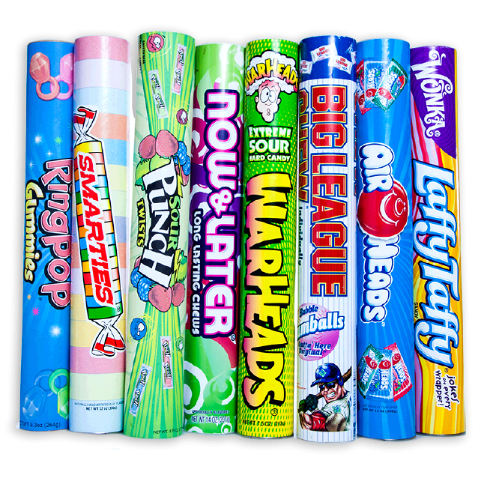
Competitive Positioning

Slide 11





Comparable Companies
FIVE vs Closest Comparable Companies
Companies | Market Cap | REVENUE | EBITDAR Margin | Number of Stores (as of Q4 2018) | Same Store Sales growth | 5-yr CAGR of EPS | TTM EV/EBITDAR | TTM P/E
FIVE | 6,899 | 1,461.7 | 23.5% | 750 | 3.2% | 35.9% | 19.7X | 52.9X
Dollar Tree | 23,009 | 22,978 | 16.7% | 15,187 | 1.5% | 16.7% | 6.3X | 11.5X
Dollar General | 30,242 | 25,104 | 14.5% | 15,227 | 2.5% | 9.4% | 8.7X | 16.6X
Big lots | 1,242 | 5,286.8 | 13.5% | 1,416 | 1.6% | 3.6% | 5.2X | 8.4X
Ollie’s | 4,989.8 | 1,204.1 | 17.2% | 303 | 2.7% | 43.6% | 25.6X | 39.3X
Business Description
Industry Overview
Competitive Positioning
Financial Analysis
Corporate Governance
Valuation
Investment Risks

Slide 12
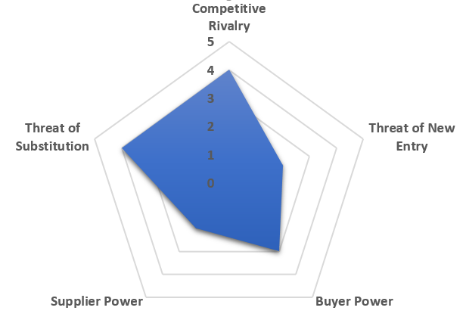
Competitive Standing
FIVE’s unique differentiators set to outlast competitors.
FIVE faces high threat of substitutes.
High barriers for new entrants enable FIVE to focus on growth.
FIVE has maintained negotiation power over tariffs.
Certain customers are relatively sticky to FIVE.
Business Description
Industry Overview
Competitive Positioning
Financial Analysis
Corporate Governance
Valuation
Investment Risks

Slide 13
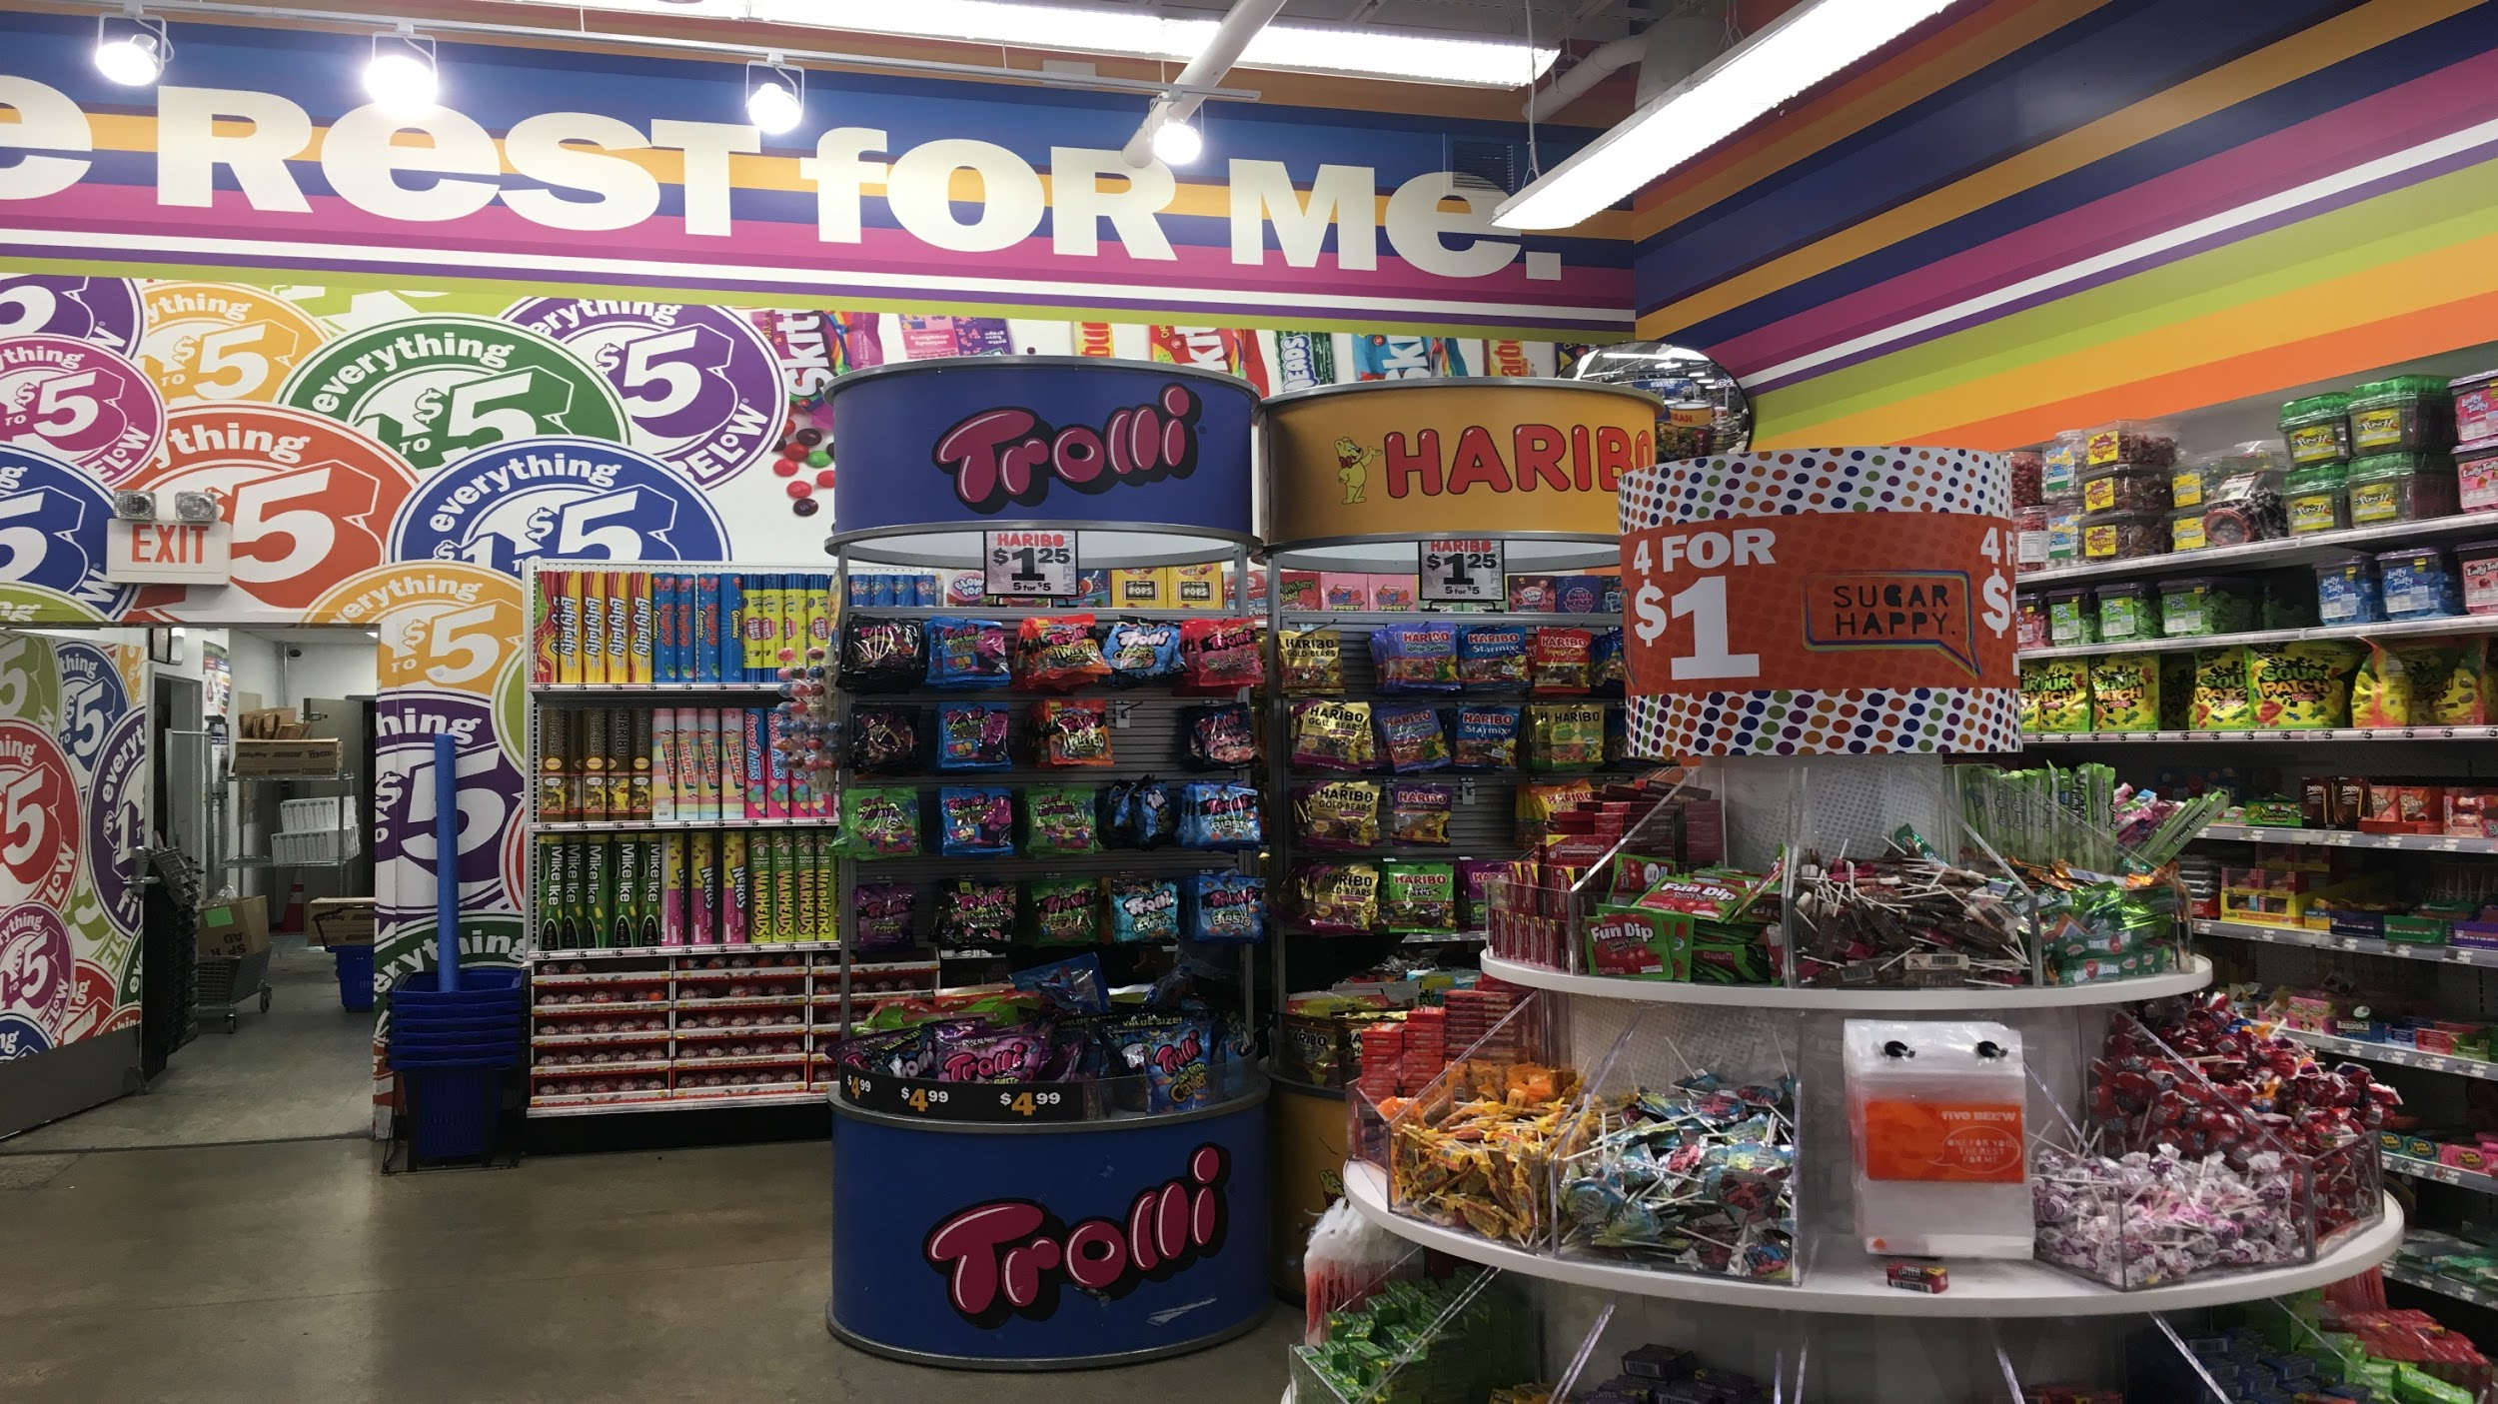
Financial Analysis

Slide 14
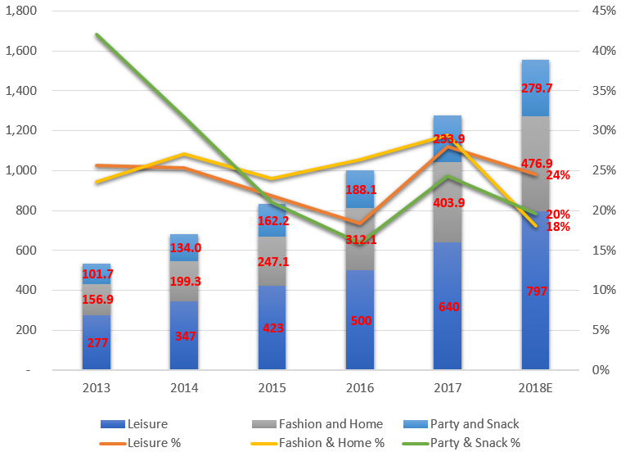
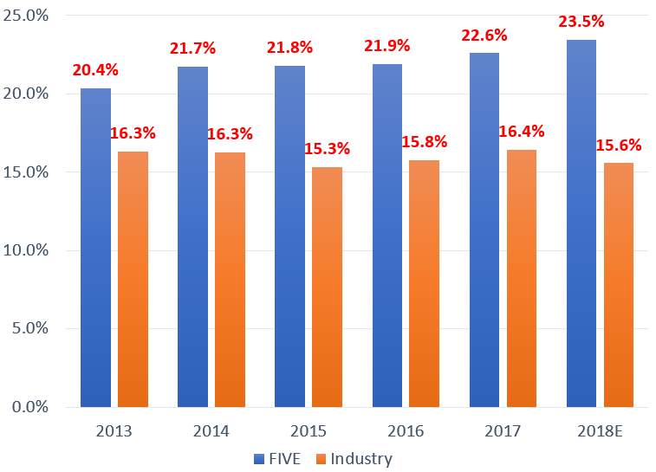
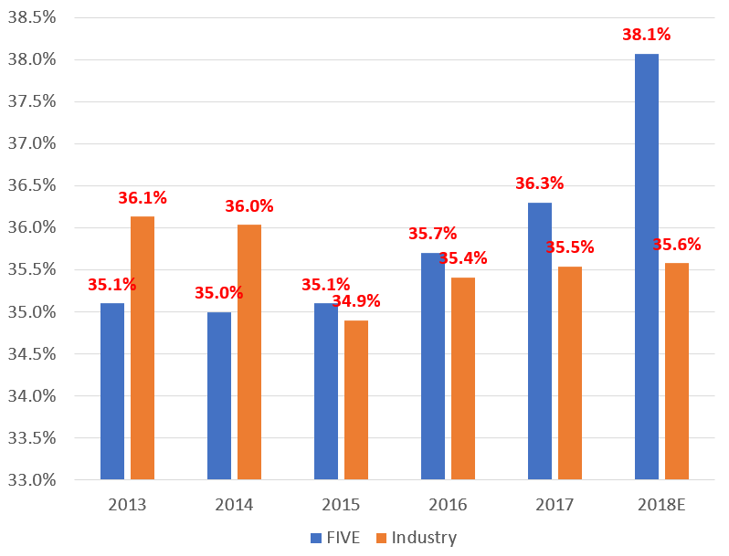
Profitability and Return
Top side growth from expansion and brand awareness
Well-controlled store related expenses and COGS
New initiatives and opportunities to drive down expenses
Segments Growth
EBITDAR Margin
Gross Margin
Net property, plant, and equipment from expansion
ROIC 5yr avg. 28.3%
VS.
Industry 5yr avg. 15.1%
Growth in operating working capital
Business Description
Industry Overview
Competitive Positioning
Financial Analysis
Corporate Governance
Valuation
Investment Risks

Slide 15
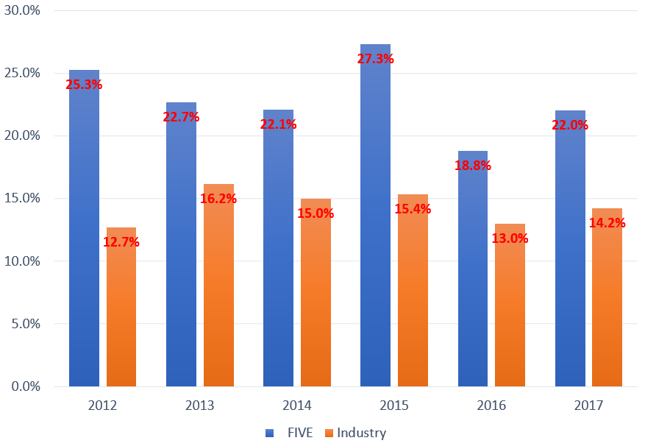
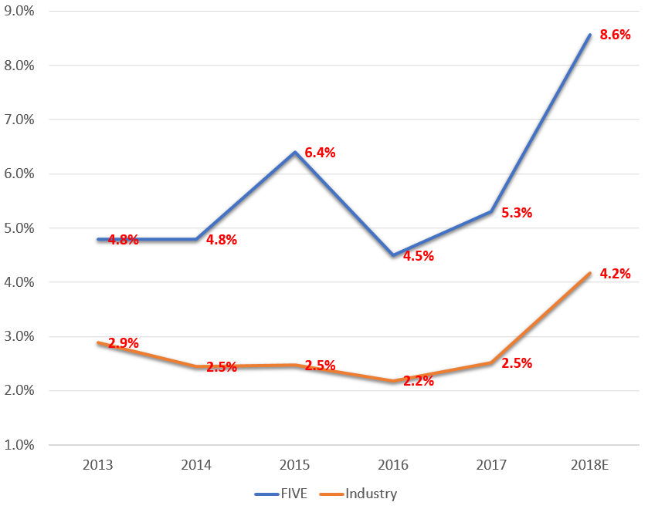
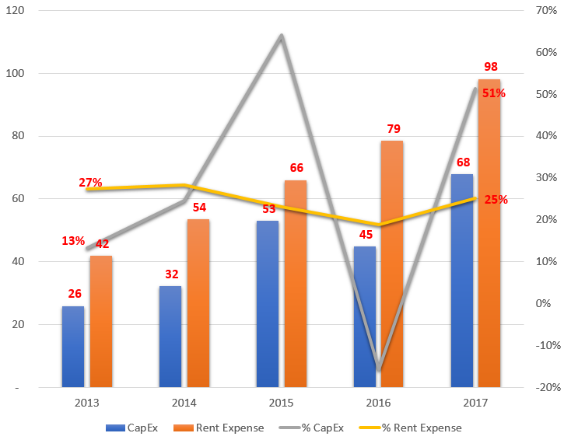
High CapEx Growth
CapEx as % of Sales
CapEx vs. Rent Expense
CapEx as % of Gross PPE
Growth drives higher CapEx
125+ stores opened annually.
$0.3m CapEx invested per store.
Southeast distribution center $42m in Q1 2019.
Southwest distribution center planned in H1 2020.
Corporate infrastructure, e.g. POS system.
CapEx turns into sales growth
CapEx growth 5yr avg. 28% vs. Sales growth 25%.
CapEx growth vs. rent expense
Store growth with good terms (rent expense growth 25%).
2018E $130m CapEx vs. $1.56bn sales.
Store growth, distribution centers, and corporate projects by CapEx.
Business Description
Industry Overview
Competitive Positioning
Financial Analysis
Corporate Governance
Valuation
Investment Risks

Slide 16
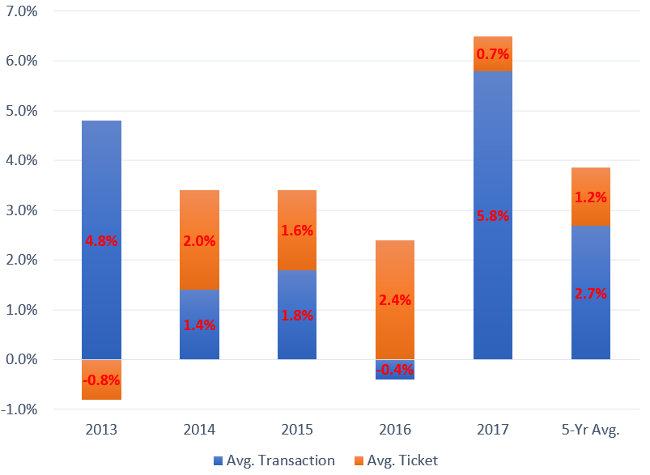
Store Performance
Transaction
Drives most growth (2.7% 5yr avg or ~69% SSS)
Ticket Sales
Stable growth in regular years (1.2% 5yr avg)
Trends drive higher growth in avg. ticket sales (2017 fidget spinner)
Shoppers avg. $15 (10x per year totaling $150)
Growing revenue per comparable store
Red Flag: Cannibalization of Comparable Stores
 | FIVE | OLLI | DG
Store Size | 8k sq.ft | 30k sq. ft | 7.4k sq.ft
Year 1 Sales ($ in M) | $2.08 | $3.90 | $1.68
Year 1 Sales Per Sq Ft | $285.20 | $130 | $230.33
Net Investment | $300k | $1M | $250k
Payback Period | < 1 year | < 2 years | < 2 years
Sales / Store Growth | 3.6% | 3.5% | 1.2%
Cannibalization ($M) | 0.11 | 0.10 | 0.00
Business Description
Industry Overview
Competitive Positioning
Financial Analysis
Corporate Governance
Valuation
Investment Risks

Slide 17
Operational Efficiency
Asset Turnover
Total Sales
$956.88M
Topline growth faster than assets growth.
Efficiency in utilizing assets to generate sales.
Asset Turnover
1.96x
÷
Total Assets
$746.53M
EBIT
$174.17M
Pretax ROA
23.82%
x
Pretax Income
$177.85M
÷
ROA
17.11%
x
Pretax Margin
18.59%
÷
Interest Expense
$3.68M
Tax Rate Complement
71.84%
Total Sales
$956.88M
ROE
28.19%
x
Pretax Margin
Total Assets
$746.53M
Effective cost control keeps gross margin attractive.
Profitability level is above the industry average.
Assets/Equity 1.65x
x
Equity
$453.19M
Business Description
Industry Overview
Competitive Positioning
Financial Analysis
Corporate Governance
Valuation
Investment Risks

Slide 18
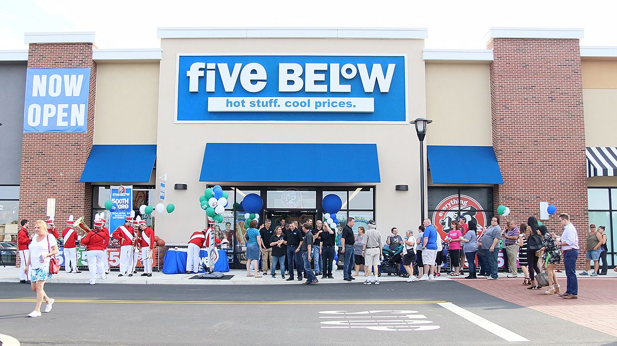
Corporate Governance

Slide 19
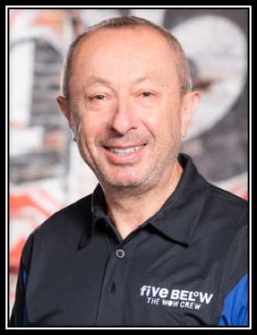
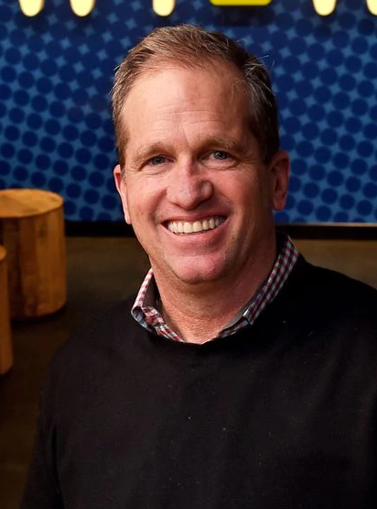

Management and The Board
Experienced leadership places confidence in management.
Independent Board and effective committees ensure the objective view of operations.
Thomas Vellios
Co-Founder and Chairman of the Board
Joel Anderson
President and CEO
George S. Hill
EVP of Operations
Business Description
Industry Overview
Competitive Positioning
Financial Analysis
Corporate Governance
Valuation
Investment Risks

Slide 20
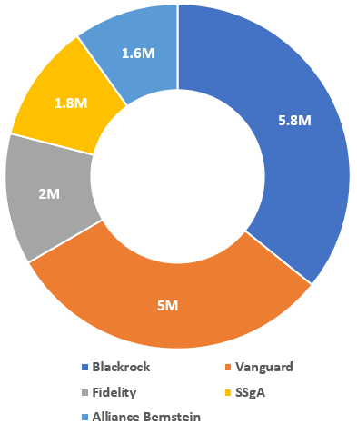
Stakeholder Ownership
Institutional Investors
Institutional stakeholders
More than 97% of the ownership structure is controlled by institutional owners.
Short Interest
SI as of % float - 6.32%
The remaining 2.5% of ownership is controlled mainly by insiders, including FIVE’s Chairman, Thomas Vellios.
Short interest fluctuates from institutional holding changes.
Business Description
Industry Overview
Competitive Positioning
Financial Analysis
Corporate Governance
Valuation
Investment Risks

Slide 21
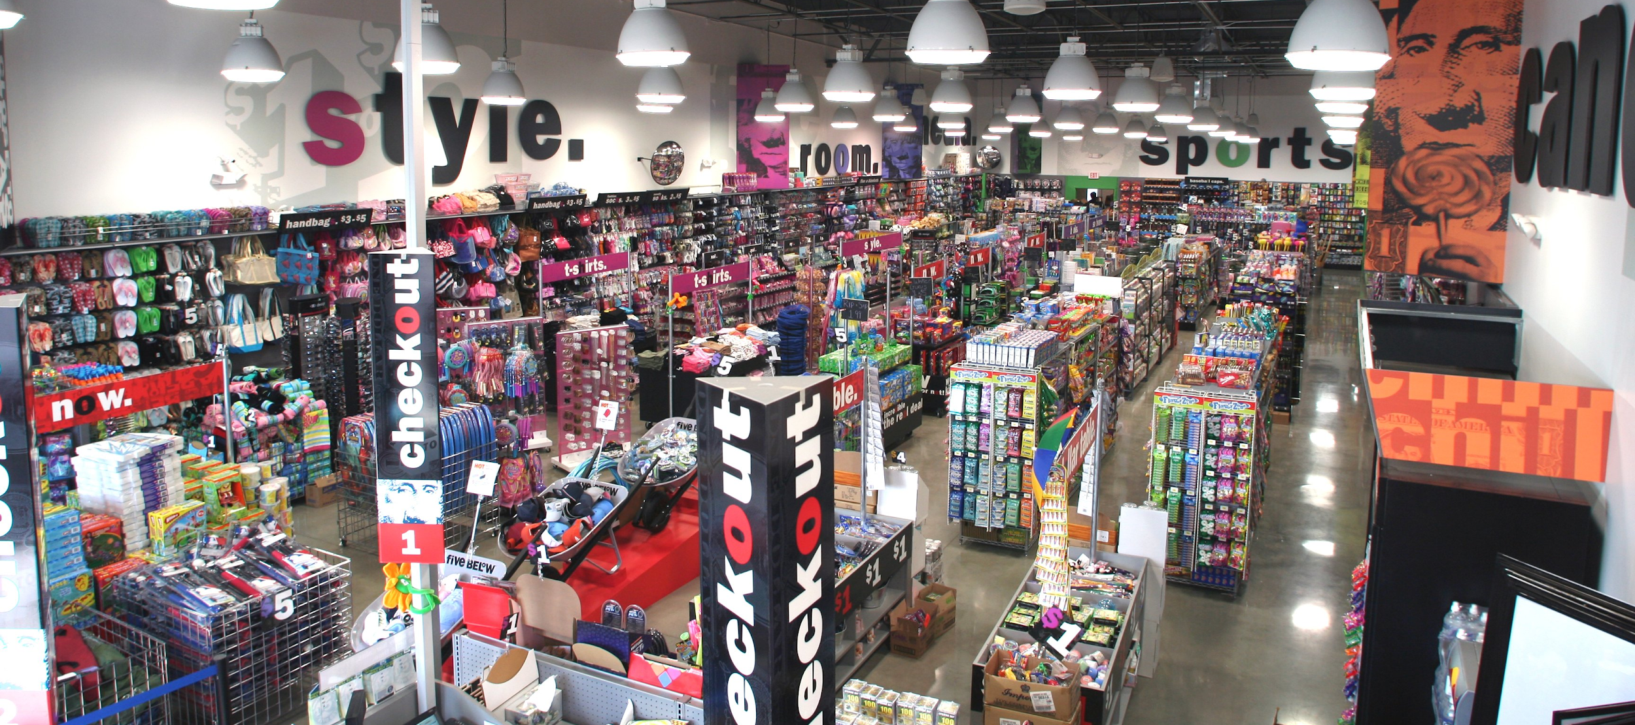
Valuation

Slide 22
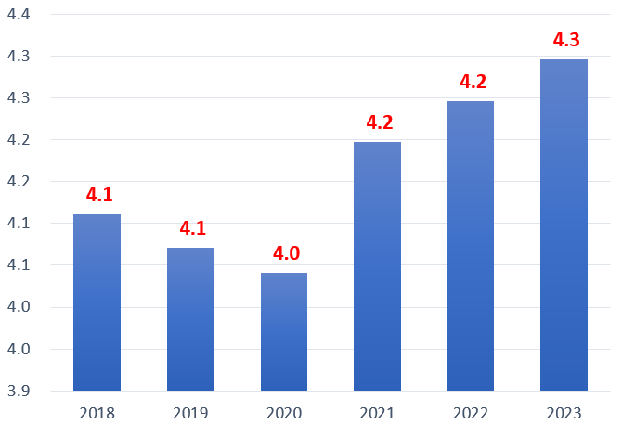
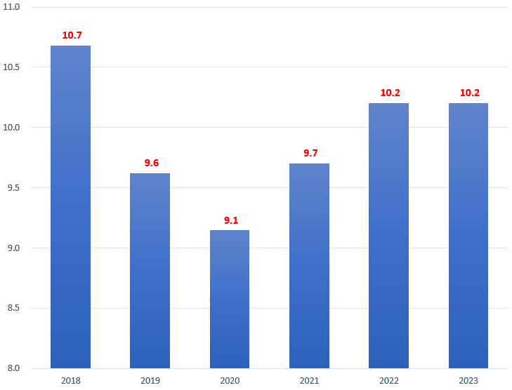
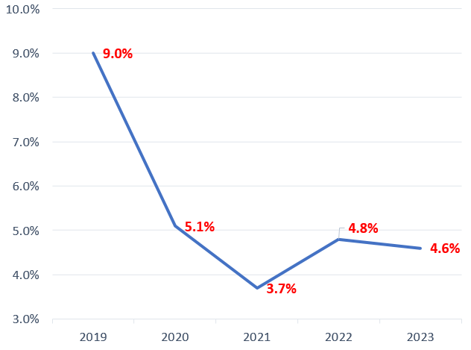
Trending Turnover
Inventories
Accounts Payable
Net PPE
Inventory turnover expected to stay above 4.0.
Store remodeling and potential slower traffic.
New store model and distribution centers in the pipeline.
Continue on negotiating with suppliers and vendors.
Digest tighter credit control due to slowing emerging markets.
Implied growth estimated by CapEx growth ~5%
50-60% of CapEx supports new store openings.
No new distribution centers expected after 2020.
V-Shape Trend for Inventory TO
V-Shape Trend for AP TO
Net PPE Growth
Business Description
Industry Overview
Competitive Positioning
Financial Analysis
Corporate Governance
Valuation
Investment Risks

Slide 23
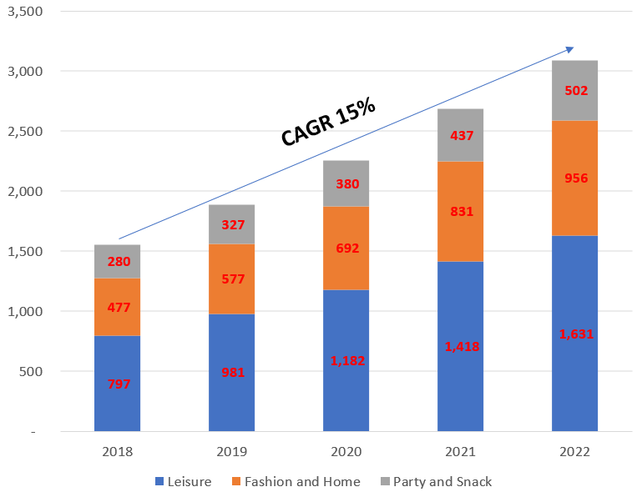
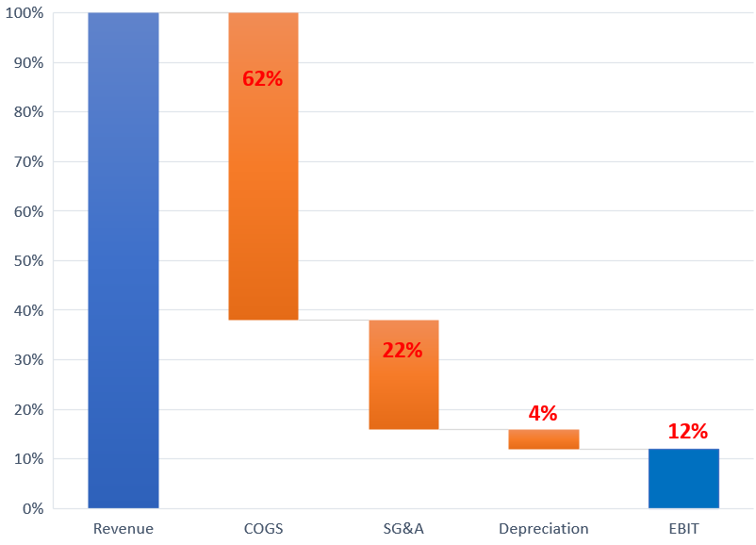
Cash Generation
Sales
20% top-line growth due to continued expansion and in-store operation improvement.
Maintain bargaining power against suppliers, leverage vendors’ scalability, outsource from other countries, and improve logistics.
New store related expenses, marketing and advertising, new distribution centers, and corporate projects.
Depreciation modeled to CapEx
COGS 62%
Gross Profit
38%
Revenue Forecast by Segments
SG&A 22%
Revenue and Costs Bridge
D&A
4%
EBIT margin
12%
Business Description
Industry Overview
Competitive Positioning
Financial Analysis
Corporate Governance
Valuation
Investment Risks

Slide 24
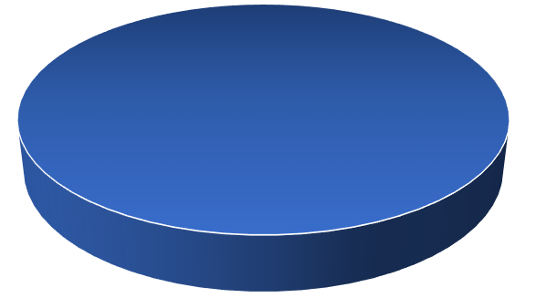
Cost of Capital
Capital Structure (Millions of USD)
WACC Computation
10-Yr Treasury Bond Yield | 2.70%
Market Premium | 7.59%
Beta | 0.84
Cost of Equity | 9.10%
Market Cap | 6,681.8 | 100.0%
ST Debt | 0.0 | 0.0%
LT Debt | 0.0 | 0.0%
Preferred Equity | 0.0 | 0.0%
Total | 6,681.8 | 100.0%
Name | D/E | Regressed Beta | Tax Rate | Unlevered Beta
FIVE | 0.0% | 1.01 | 28.2% | 1.01
DLTR | 63.5% | 0.79 | -11.4% | 0.75
DG | 45.7% | 0.69 | 9.1% | 0.72
BIG | 104.5% | 0.88 | 33.2% | 0.80
OLLI | 2.2% | 0.95 | -2.1% | 0.94
 |  |  | Average | 0.84
Cost of Capital 9.10%
Business Description
Industry Overview
Competitive Positioning
Financial Analysis
Corporate Governance
Valuation
Investment Risks

Slide 25
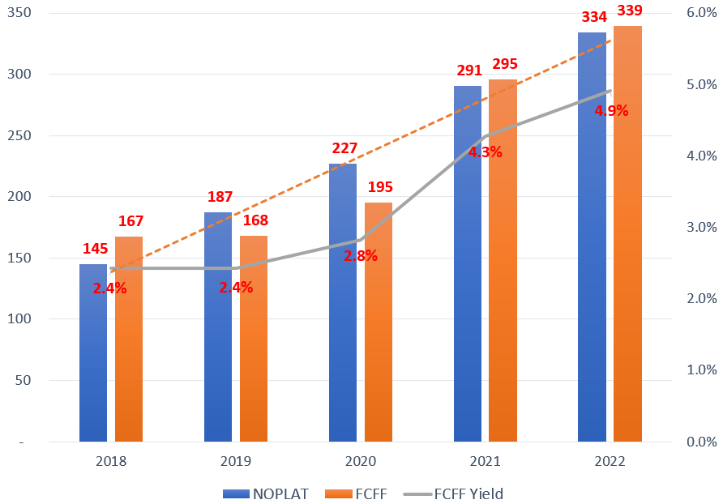
Enterprise Value
DCF
Accrued Payroll
Employee Stock Options
Intrinsic Equity Value
11.1m as of Q3 2018
NOPLAT & Free Cash Flow
Terminal Growth | After 2030
% Leisure | 5.0%
% Fashion and Home | 5.0%
% Party and Snack | 5.0%
% COGS | 5.0%
% SG&A | 2.5%
% D&A | 2.5%
Tax | 21.0%
24.6m using $42 exercise price
$7,150.66m
DCF Target Price
$128.24
Business Description
Industry Overview
Competitive Positioning
Financial Analysis
Corporate Governance
Valuation
Investment Risks

Slide 26
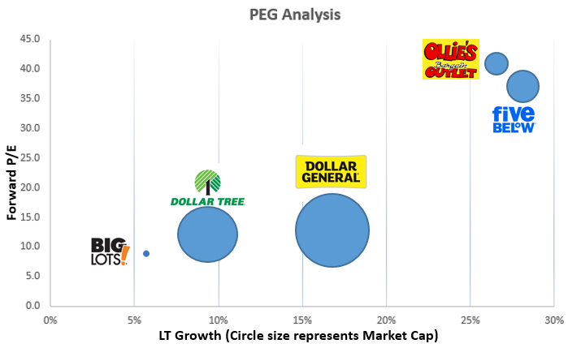
Justified Multiples
EV/EBITDAR
Rent expense excluded:
- A significant amount that impacts operation.
- Not related to core business.
- Varies substantially from company to company.
PEG
- Expensive P/E 39.4x among peers 20.0x.
- Forecasted 2019 forward earnings $174.9m.
- Accounted for high growth (28.2% in 2019) of the company.
Forward EBITDAR
$459.35m
Price Target
$135.12
Average Industry Forward EV/EBITDAR
15.32x
Price Target
$132.01
Forward PEG 1.40x
Business Description
Industry Overview
Competitive Positioning
Financial Analysis
Corporate Governance
Valuation
Investment Risks

Slide 27
Target Price
DCF $128.24
EV/EBITDAR $135.12
PEG $132.01
Target Price
$129.94
Business Description
Industry Overview
Competitive Positioning
Financial Analysis
Corporate Governance
Valuation
Investment Risks

Slide 28
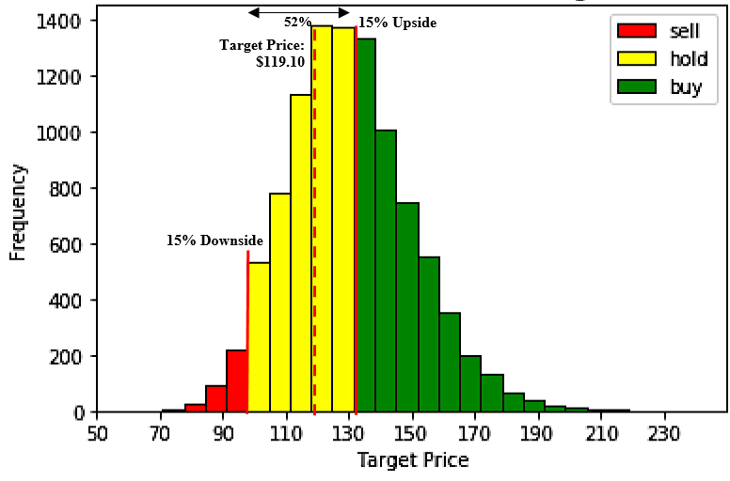
Sensitivity
Sensitivity Analysis
Scenario Analysis
Monte Carlo Simulation
Value of Operation
WACC | Terminal Growth
 | 3.0% | 3.5% | 4.0% | 4.5% | 5.0% | 5.5% | 6.0% | 6.5% | 7.0%
7.1% | 142 | 147 | 154 | 164 | 178 | 201 | 220 | 235 | 245
7.6% | 126 | 129 | 133 | 139 | 146 | 158 | 176 | 190 | 210
8.1% | 118 | 125 | 130 | 135 | 139 | 144 | 150 | 156 | 161
8.6% | 110 | 115 | 121 | 126 | 131 | 138 | 145 | 151 | 157
9.1% | 105 | 110 | 116 | 122 |  | 135 | 142 | 148 | 154
9.6% | 99 | 105 | 111 | 117 | 124 | 130 | 136 | 142 | 148
10.1% | 88 | 94 | 97 | 102 | 108 | 115 | 118 | 120 | 125
10.6% | 84 | 87 | 92 | 95 | 98 | 101 | 105 | 108 | 112
11.1% | 78 | 80 | 83 | 88 | 92 | 96 | 101 | 104 | 109
1400
9% Upside
Bull Case
$145.36
1200
$129.94
1000
800
600
9% Downside
Bear Case
$93.90
128
400
200
60
80
100
120
140
160
180
200
220
240
Business Description
Industry Overview
Competitive Positioning
Financial Analysis
Corporate Governance
Valuation
Investment Risks

Slide 29
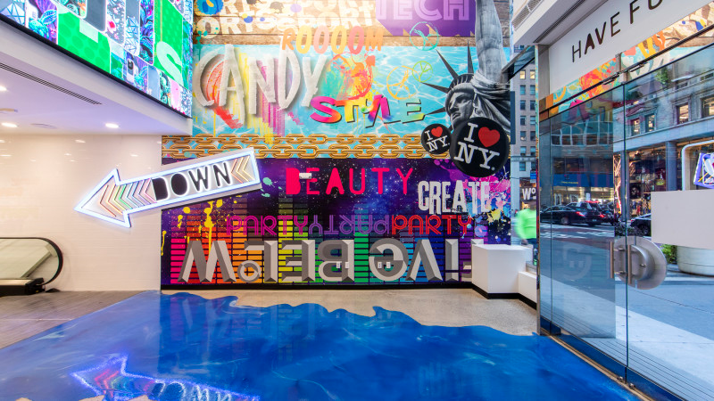

Investment Risks

Slide 30
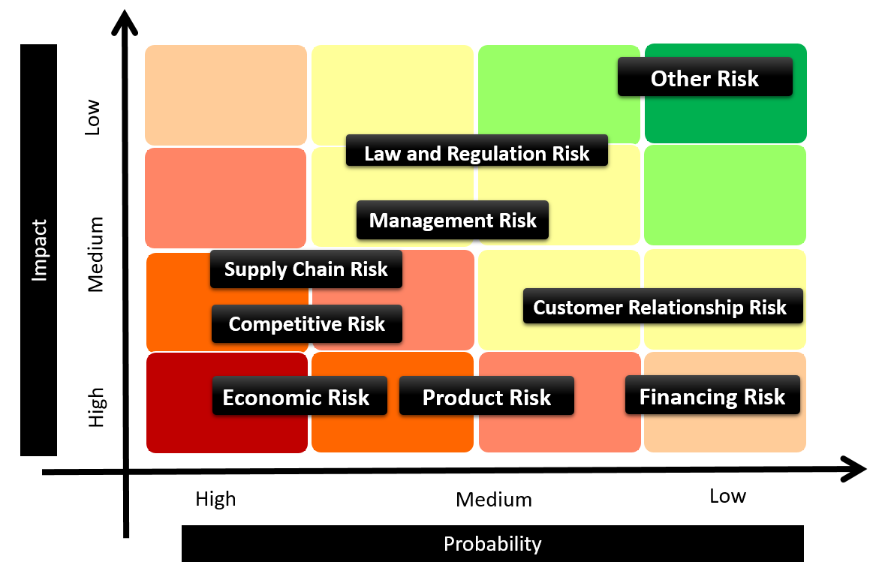
Risk Matrix
Business Description
Industry Overview
Competitive Positioning
Financial Analysis
Corporate Governance
Valuation
Investment Risks

Slide 31
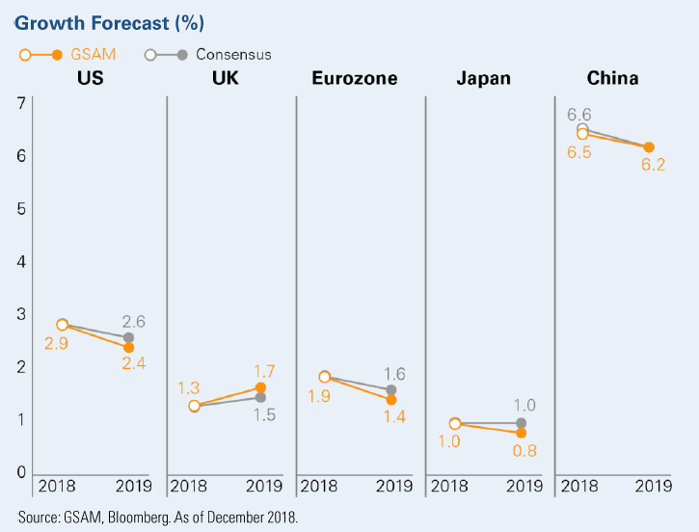
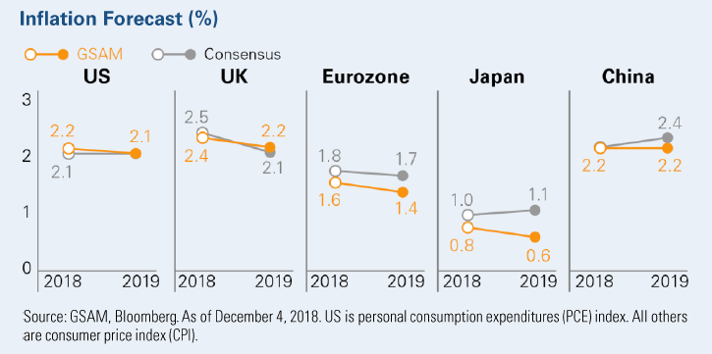
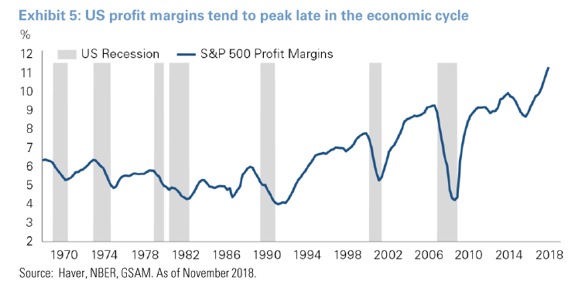
Economic Outlook
Inflation
Trade Tariffs
Economic slowdown
Business Description
Industry Overview
Competitive Positioning
Financial Analysis
Corporate Governance
Valuation
Investment Risks

Slide 32
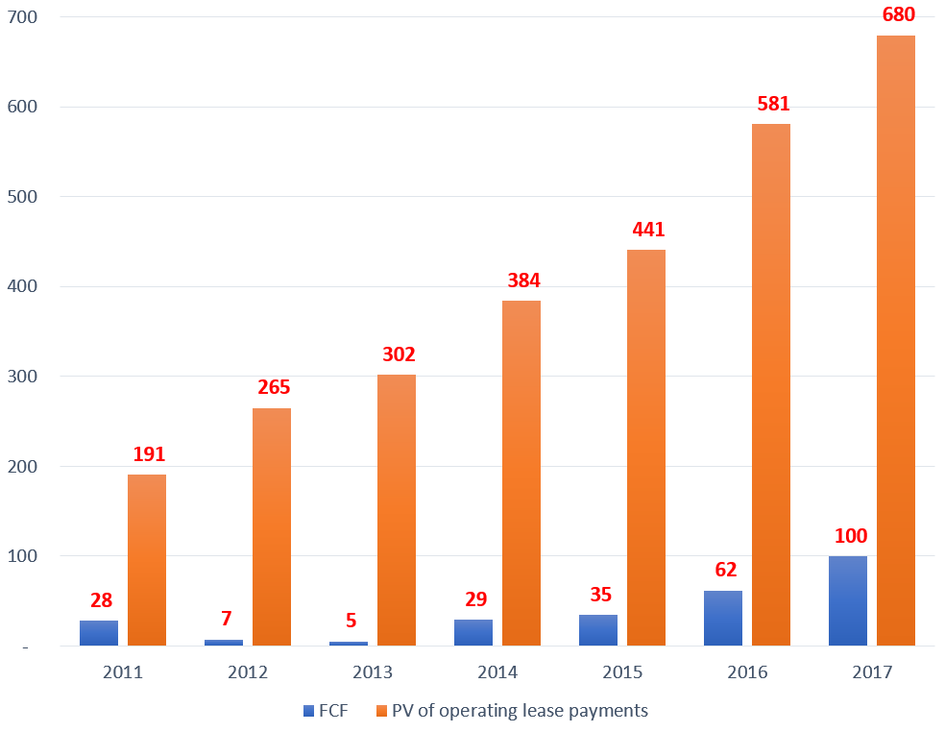
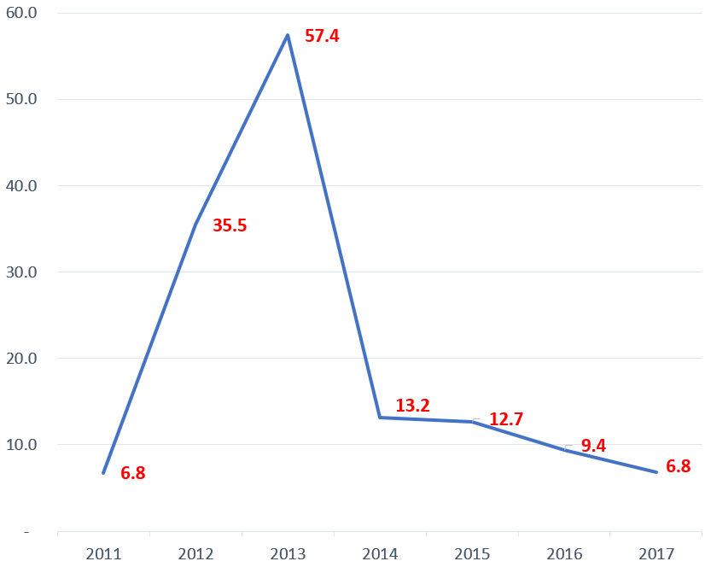
Leasing Obligation Coverage
Potential high leverage from leasing obligations?
Could expansion drive FCF to offset leasing obligations?
Leasing Obligations vs. FCF
Leasing Obligations Coverage Ratio
Business Description
Industry Overview
Competitive Positioning
Financial Analysis
Corporate Governance
Valuation
Investment Risks

Slide 33
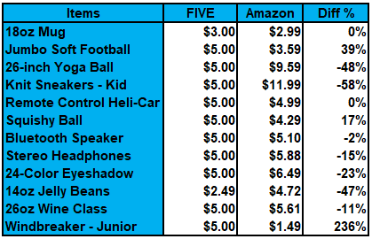
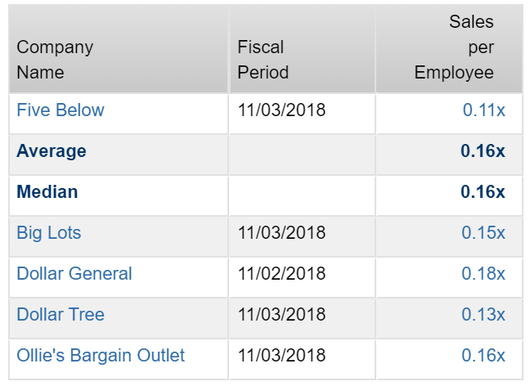
Competitive Risks
E-commerce giant might take away foot traffic for FIVE?
Lower sales per employee because FIVE is overstaffed or bad training? What is the indication?
Price Comparison to Amazon
Sales per Employee Comparison
Source: Factset
Business Description
Industry Overview
Competitive Positioning
Financial Analysis
Corporate Governance
Valuation
Investment Risks

Slide 34
Other Risks
Labor Risk
Operational Risk
IT Risk
Liquidity Risk
Law and regulation Risk
Other Risk
Low wage (average $8.67/hr) and high employee turnover rate
Highly rely on third party transportation to distribute its products from its DC to stores
IT glitch (fail to secure customers’ financial and personal information)
Line of credit up to $20.0 million under the condition to maintains eligible inventory equal to at least $100 million
A congressional debate regarding a potential cutback to the provision of food stamps is underway
Extreme weather, natural disaster, pandemic outbreaks, war, terrorism, and so on
Business Description
Industry Overview
Competitive Positioning
Financial Analysis
Corporate Governance
Valuation
Investment Risks

Slide 35

Conclusion
Concern of Expansion Pace
Likely Economic Slowdown
Uncertainty on Trade Tariffs
HOLD
5.0%
Target Price
$129.94

Slide 36
Q&A

Slide 37
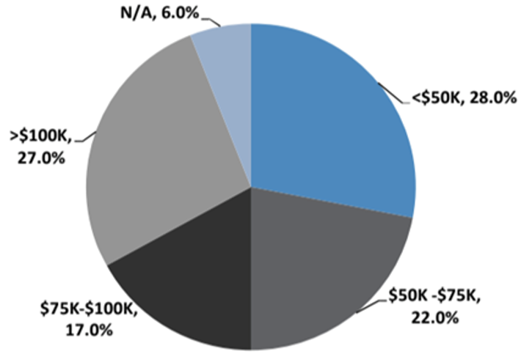

Appendix 1
Store Visit by Income Classes
Average Store Visit Time Spent
Source: FIVE Investor Presentation 2017
Source: FIVE Investor Presentation 2017

Slide 38


Appendix 2
Revenue and EPS
ROIC
Source: Factset, Team Assessment
Source: Factset, Team Assessment

Slide 39


Appendix 3
Net Operating Cycle
FCF Growth
Source: Factset, Team Assessment
Source: Factset, Team Assessment

Slide 40


Appendix 4
Balance Sheet Forecast Assumptions
Income Statement Forecast Assumptions
Source: Factset, Team Assessment
Source: Factset, Team Assessment

Slide 41


Appendix 5
WACC
Base Case DCF
Source: Team Assessment

Slide 42


Appendix 6
Base Case DCF – Pro Forma

Slide 43


Appendix 7
EBITDAR
EV Multiples
Price Multiples
Source: Factset, Team Assessment

Slide 44

Appendix 8
Black-Scholes Option Model
Source: Team Assessment

Slide 45

Appendix 9
Bull Case DCF
Source: Team Assessment

Slide 46

Appendix 10
Bear Case DCF
Source: Team Assessment

Slide 47


Appendix 11
Consumer Spending vs. CEI
U.S. Demographics by Ages
Source: Bloomberg

Slide 48


Appendix 12
Total Employment
Net Advertising Spending
Source: eMarketer Retail
Source: eMarketer Retail

Slide 49


Appendix 13
Source: NYU

Slide 50

Appendix 14
Digital Marketing/Social Media Effort
Source: eMarketer Retail

